Slide 1
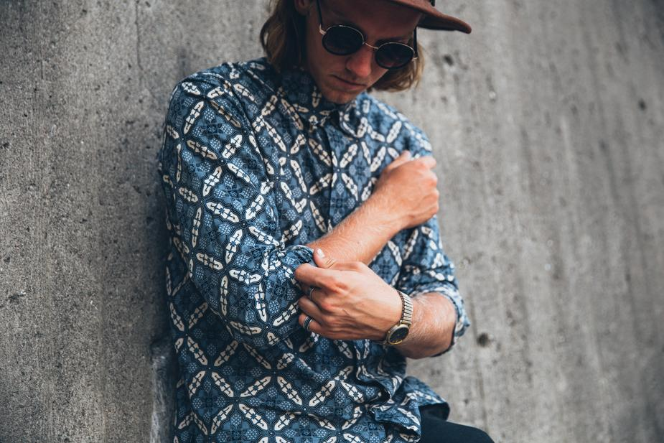
Blue Pattern Shirt
Cotton buttoned shirt with classic but modern pattern.
Materials | Cotton
Sizes | S, M, L
Availability | Retail, Online
Jarrett's 2021 Collection

Slide 2
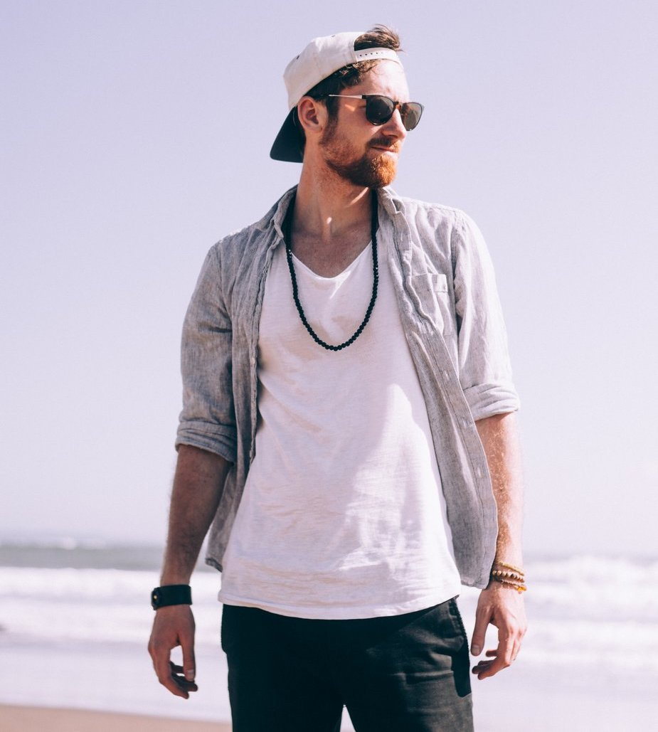
Linen washed shirt
Casual gray linen shirt, washed process.
Materials | Linen
Sizes | S, M, L
Availability | Retail, Online
Imported from | Italy
Jarrett's 2021 Collection

Slide 3
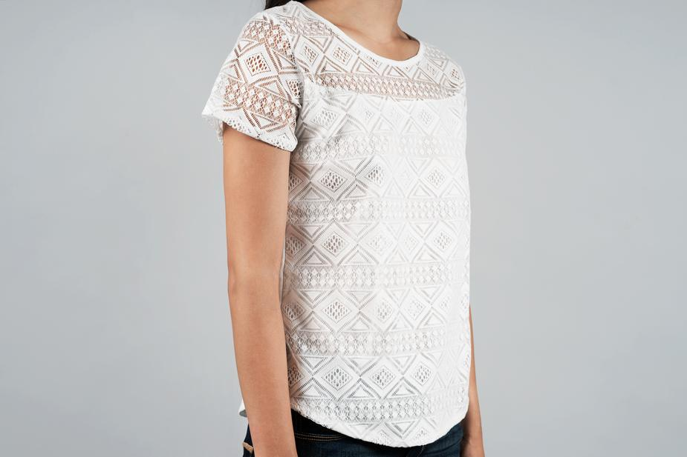
Lace Blouse
White lace blouse with geometric pattern stitching.
Materials | Cotton
Sizes | M
Availability | Online
Imported from | Spain
Sustainability | OEKO-TEX Standard 100 certified
Jarrett's 2021 Collection

Slide 4
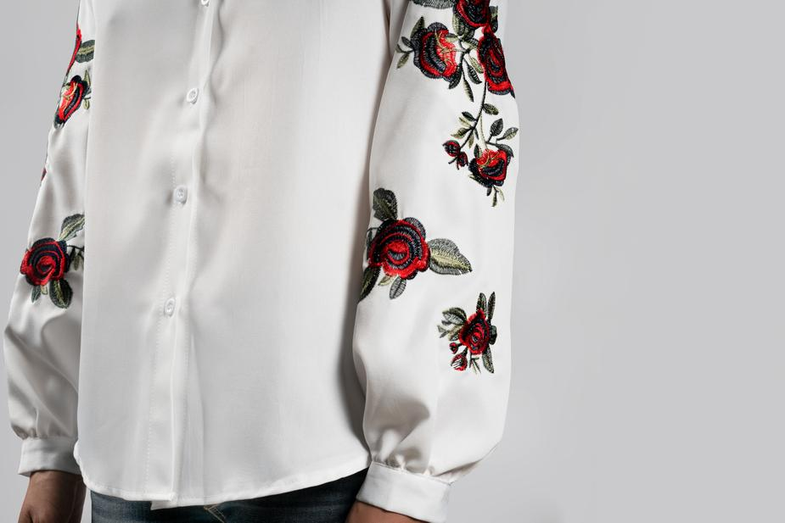
Rose stitched blouse
Long-sleeve blouse with rose stitchings. Silky feel, with puffed sleeves.
Materials | Polyester, Linen
Sizes | S, M, L
Availability | Retail
Jarrett's 2021 Collection

Slide 5
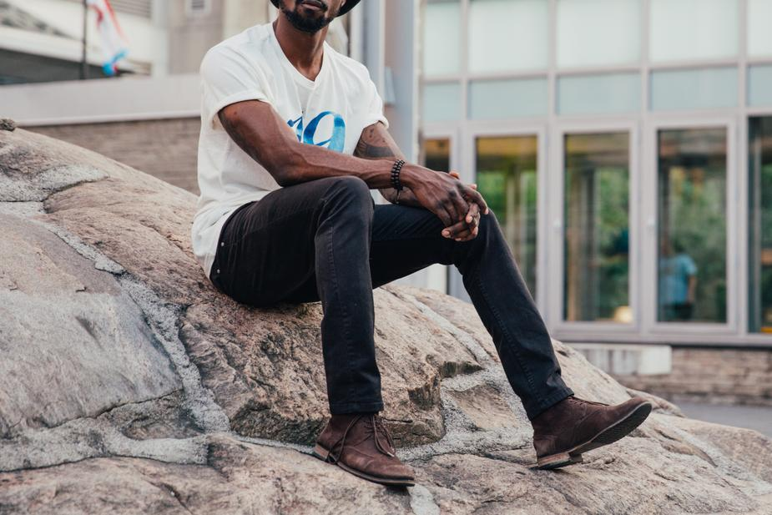
Dark jeans
Basic dark jeans. Slim silhouette.
Materials | Cotton
Sizes | S, M, L
Availability | Retail, Online
Jarrett's 2021 Collection

