Slide 1
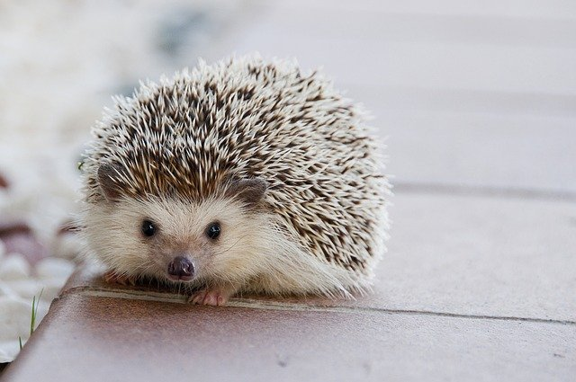
"scaling": "contain"
SlidePack Example: Image scaling
With {"scaling": "contain"}, the image is resized to fit within the shape.
With {"scaling": "cover"}, the image is resized to cover the entire shape. As a result, the image may overflow either horizontally or vertically.
When scaling is unspecified or null, the image is placed as-is according to its intrinsic size.
Notes:
Image by Amaya Eguizábal from Pixabay.
https://pixabay.com/photos/hedgehog-cute-animal-little-nature-1215140/

Slide 2
"scaling": "cover"
SlidePack Example: Image scaling
With {"scaling": "contain"}, the image is resized to fit within the shape.
With {"scaling": "cover"}, the image is resized to cover the entire shape. As a result, the image may overflow either horizontally or vertically.
When scaling is unspecified or null, the image is placed as-is according to its intrinsic size.
Notes:
Image by Amaya Eguizábal from Pixabay.
https://pixabay.com/photos/hedgehog-cute-animal-little-nature-1215140/

Slide 3
"scaling": null
SlidePack Example: Image scaling
With {"scaling": "contain"}, the image is resized to fit within the shape.
With {"scaling": "cover"}, the image is resized to cover the entire shape. As a result, the image may overflow either horizontally or vertically.
When scaling is unspecified or null, the image is placed as-is according to its intrinsic size.
Notes:
Image by Amaya Eguizábal from Pixabay.
https://pixabay.com/photos/hedgehog-cute-animal-little-nature-1215140/

